Slide 1
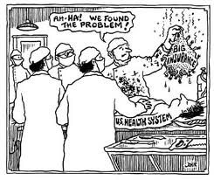
Sustainable Quality Health Care Single Payer is not an Answer, it is the Answer
Gerald Friedman
Professor of Economics
University of Massachusetts at Amherst
July 29, 2013
gfriedma@econs.umass.edu
Twitter: @gfriedma

Slide 2
Bottom Line: HR 676 (Improved Medicare-for-All) can be funded
In 2014:
Saves $592 billion in wasteful administrative spending and excessive drug prices
After $394 billion in system improvements, saves nearly $200 billion
Local and state governments save $283 billion in Medicaid and employee health benefits
95% would save money
Over decade
Funding program for would produce $3 trillion in federal deficit reduction
State and local governments save $5 trillion
Health care spending falls by over $8 trillion

Slide 3
Problem I: unsustainable increases in health care costs
7% of GDP in 1970; 18% in 2010; 20% in 2021

Slide 4
Rising Health Care burden on household budgets
Health care spending 6% of average wage in 1970, 20% in 2010, 24% in 2021

Slide 5
Rising copays and deductibles
Source: http://kff.org/health-costs/issue-brief/snapshots-the-prevalence-and-cost-of-deductibles-in-employer-sponsored-insurance/

Slide 6
Rising medical bankruptcy: More bankruptcies due to medical bills

Slide 7
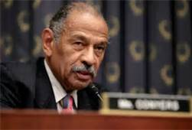
Solution: “To provide for comprehensive health insurance coverage for all United States residents, improved health care delivery, and for other purposes” (HR 676)
Expanded and Improved Medicare for All! Introduced by Representative John Conyers and 52 co-sponsors
Builds on success of Medicare Program

Slide 8
It works for Medicare. We would not have a health care financing crisis with Medicare for all

Slide 9
Savings from HR 676

Slide 10
Changes with HR 676 Savings from single funding source
Eliminates most administrative overhead in insurance industry
Eliminates most billing and insurance related expenses for providers
Can bargain to eliminate monopoly pricing of drugs and other medical supplies

Slide 11
Program Improvements with HR 676,) 2014 (Added costs)
$394 in extra spending

Slide 12
Added costs and system improvements
Expanded coverage to all residents
Elimination of underinsurance leads to greater utilization of health care services
Elimination of differential under-pricing for Medicaid
Retraining costs for displaced insurance and billing workers
Purchase of existing for-profit facilities

Slide 13
Savings grow over time Projected Personal Health Care Spending ACA vs HR 676
Assuming growth rate of per capita expenditures would slow to rate of countries with single-payer systems, 10 year savings of over $8 trillion or 4% of GDP. Reduction in Federal deficit of nearly $2 trillion.

Slide 14
Can we pay for it?
Yes! HR 676 provides for a progressive tax program that would fund Improved Medicare for All while increasing economic efficiency
Progressive income taxes
Progressive payroll taxes
Financial transaction tax

Slide 15
Funding: we start with what we need, and what we already have
Total : Baseline spending plus HR 676 program improvements | $ 3,556
Remaining revenue sources
Federal Medicare, Medicaid, and other health spending, and 20% of current out-of-pocket spending | $ 1,454
Savings from administrative efficiencies and reduced monopolistic drug pricing | $ 592
Tax expenditure savings (corporate taxes) | $ 260
Net revenue needs | $ 1,250

Slide 16
New, Progressive Revenues
Tobin tax of 0.5% on stock trades and 0.01% per year to maturity on transactions in bonds, swaps, and trades. | $ 442
6% Surtax on household incomes over $225,000 | $ 279
6% tax on property income from capital gains, dividends, interest, profits, and rents | $ 310
6% payroll tax on top 60% with incomes over $53,000 | $ 346
3% payroll tax on bottom 40% with incomes under $53,000 | $ 27
Total additional revenues | $ 1,404
Net surplus for deficit reduction | $ 154

Slide 18
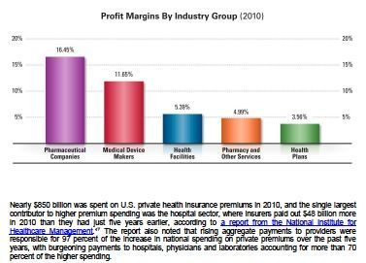
$850 Billion spent on Health Insurance Premiums in 2010
Medical Mutual: US Healthcare Costs, 2010

Slide 19
Distributional Impact of HR 676 Almost all save money
Note: Assumes current Federal Medicare taxes and spending remains

Slide 20
10 year deficit reduction of $3 trillion Money for education, infrastructure, training. Even for tax cuts.
Deficit reduction will be greater because of faster economic growth

Slide 21
Instead of waste and administrative abuse, money for families and businesses

Slide 22
In 1965, our parents and grandparents created Medicare and began to create a healthier, more productive America.

Slide 23
Let’s finish their work. HR 676: costs less today, costs less tomorrow, covers everyone

